Slide 1



AI Skin Saviors
Skin Lesion Classification
with Artificial Intelligence
. . . . . . . . . Saniya Kolangde . . . . . . . . .
. . . . . . . . Abubaker Suliman. . . . . . . . .
. . . . . . . Kanisha Krishnakumar. . . . . . .
. . . . . . . . . . Reza Saboori . . . . . . . . . . . .
. . . . . . . . . . . .Ramya Rajan . . . . . . . . . . .

Slide 2


Slide 3
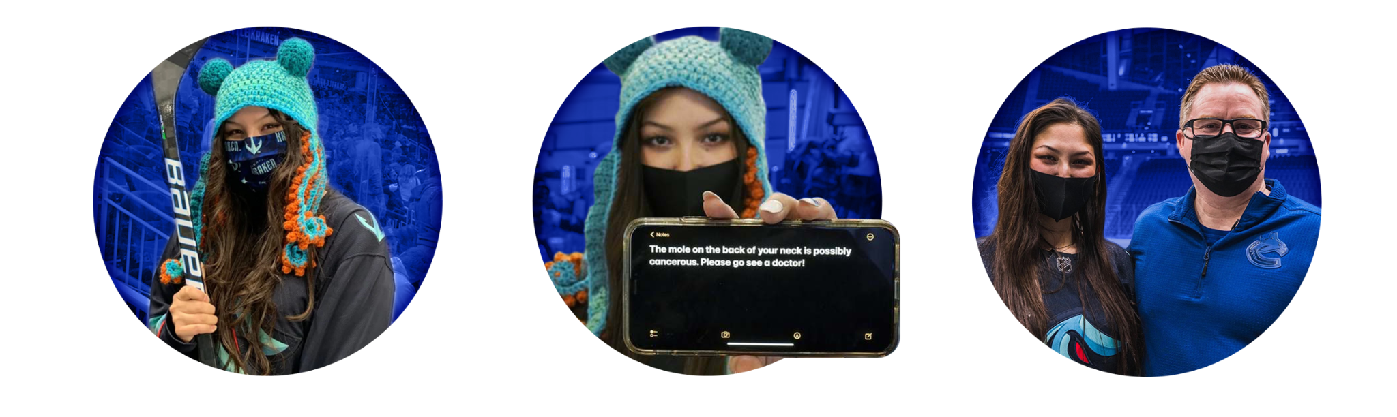
Notes:
Images reference :
https://www.gofundme.com/f/help-send-nadia-popovici-to-med-school
https://www.reddit.com/r/MadeMeSmile/comments/rtzyp2/hockey_fan_nadia_popovici_left_with_canucks/
https://www.cbc.ca/news/canada/british-columbia/seattle-kraken-brian-hamilton-cancer-1.6301987

Slide 4
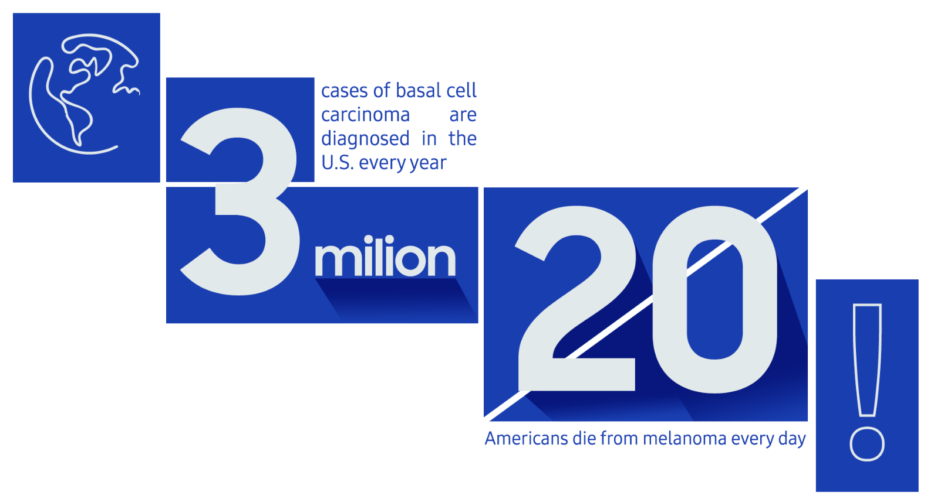
Notes:
Reference : https://www.aad.org/media/stats-skin-cancer

Slide 5
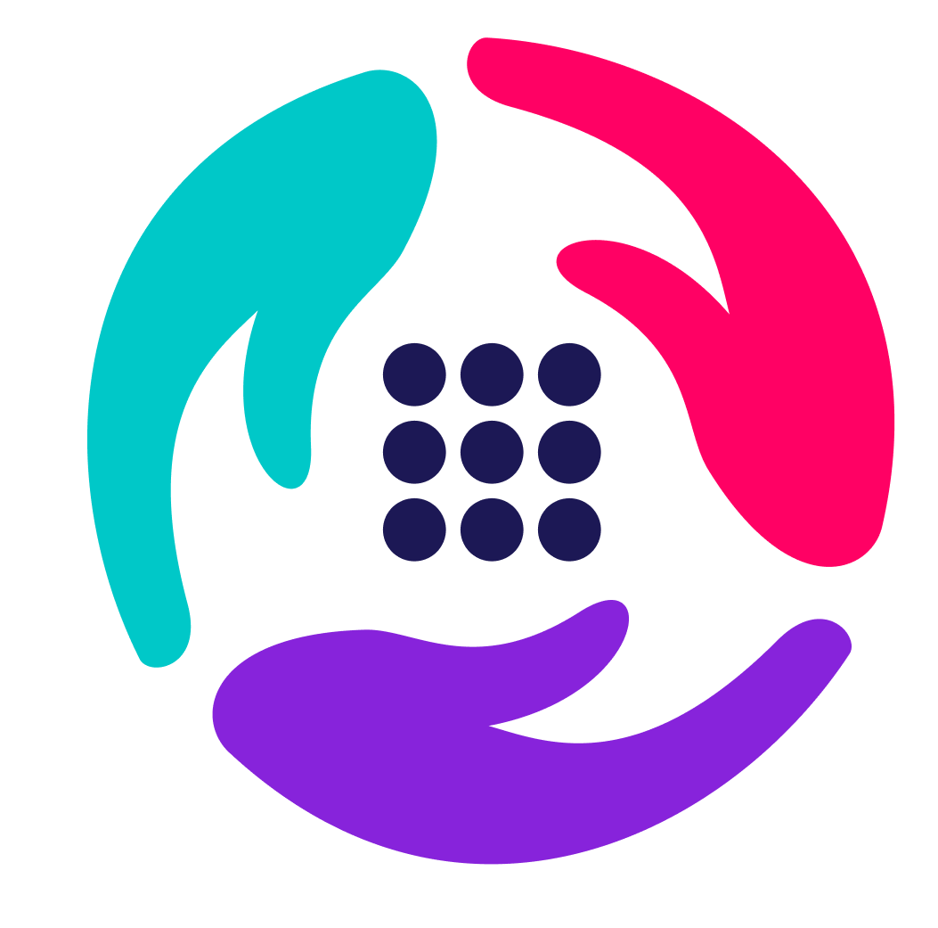
AI Skin Saviors
AI-based web application that can predict the given skin lesion image taken by dermatoscopy and saves lives by early diagnosis.

Slide 6

Project Scope
What will our project cover?

Slide 7
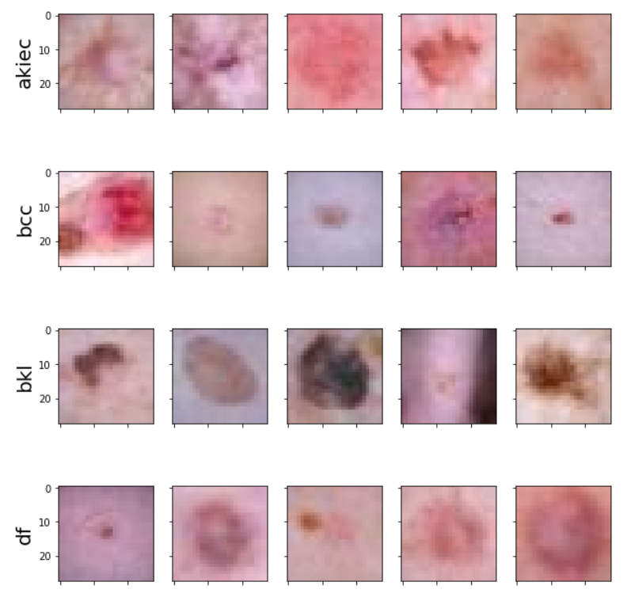
Project scope includes a deep learning model, totaling 7 classes with 3 malignant classes.
Accuracy aimed: Above 75%
Training: 7007 pictures
Validation: 1003 pictures
Testing: 2005 pictures
The web application will allow prediction of a skin lesion aiding the medical technicians and doctors.

Slide 8

The most common form of cancer, skin cancer warrants early detection, and medical attention, requiring medical data exploration.
Skin lesions prompting greater urgency are set in an online medical database via the AI Skin Saviors project.

Slide 9

Data Processing
How is the data managed?

Slide 10
We have used ImageDataGenerator API from tensorflow
Argument | Value
Rescale | 1./255
Rotation range | 90
Zoom range | 0.1
Width shift range | 0.1
Height shift range | 0.1
Horizontal flip | True
Vertical flip | True
Fill mode | 'nearest'

Slide 11

Training Method
How is our model trained?

Slide 12
Divide the data into training, validation and testing sets.
Create a sequential CNN keras model with multiple layers.
Model was built with Keras and Tensorflow version 2.7.0
Select best hyperparameters
Batch size = 128
Epochs = 230
Learning Rate = 0.00013
Use Optimizer and Focal Loss function

Slide 13
Model Layers
2D Convolutional Layer
Learn parameters through training
Pooling Layer
Reduce the dimensions of the feature maps
Flatten Layer
Convert data to 1D array for next layer input
1
3
5
2
4
6
Batch Normalization
Standardize the inputs to a layer for each mini-batch
Dropout Layer
Prevent overfitting by setting random inputs to 1 & 0
Dense Layer
Fully connected layer with neurons & activation function

Slide 14
mel = 142
vasc = 6705
nv = 1113
df = 115
def detcet_lesion(X):
return 'vas'
Model.acc = 67%
bkl = 1099
bcc = 514
akiec = 327

Slide 15
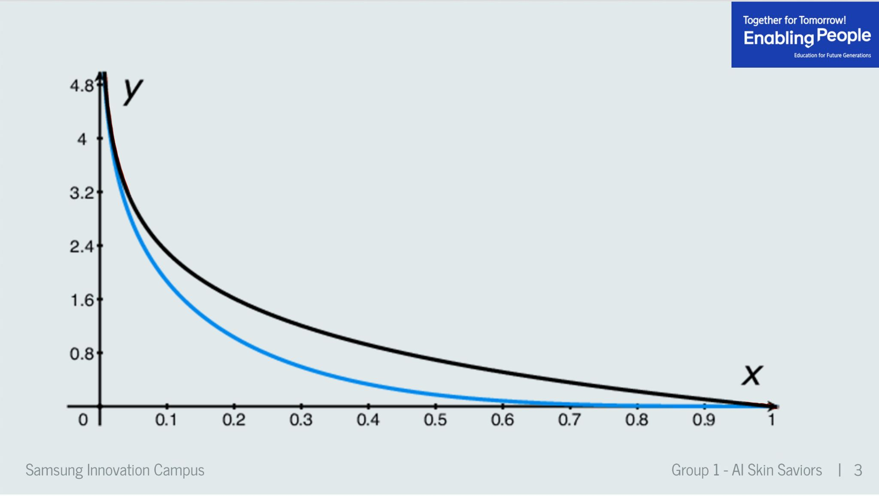
Focal loss
modulating factor
Focal loss
Cross entropy loss

Slide 16
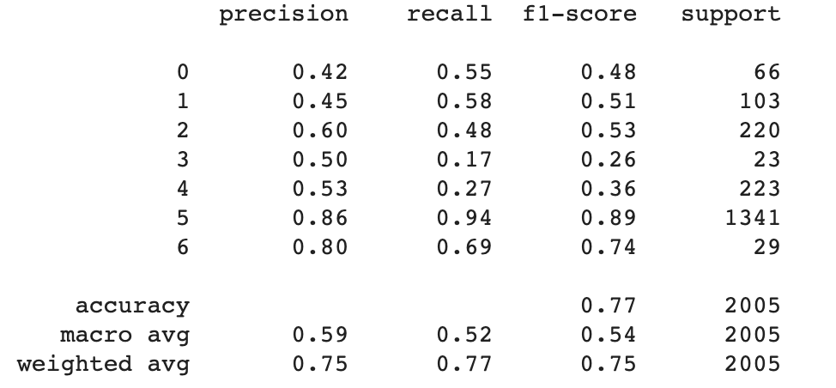
Model Evaluation
akiec
bcc
bkl
df
mel
nv
vasc

Slide 17

Expected Outcome
What are we going to deliver?

Slide 18
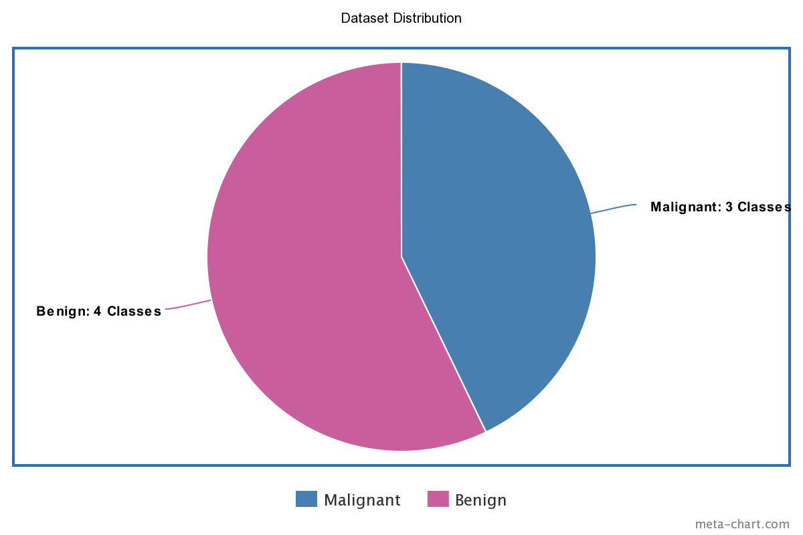
Outcome from this project is the Deep learning model and the web app utilizing this model.
Keras and TensorFlow was used to improve a deep learning model.
Classes: Actinic keratoses and intraepithelial carcinoma, Basal cell carcinoma, Benign keratosis-like lesions, Dermatofibroma, Melanoma, Melanocytic nevi, Vascular lesions.

Slide 19
The overarching expected outcome of AI Skin Saviors have utilized Keras and TensorFlow to improve a deep learning model, thus cultivating a neural network.
Consequently, this model will process images and classify them into seven different classes that include Actinic keratoses and intraepithelial carcinoma, Basal cell carcinoma, Benign keratosis-like lesions, Dermatofibroma, Melanoma, Melanocytic nevi, and Vascular lesions. Out of these 7 classes, patients with a higher tendency for skin cancer fall under 3 malignant classes.
The model is be trained extensively with a training set to achieve maximum accuracy of above 75%. To deal with the data imbalance problem, a SparseCategoricalFocalLosswas used specifically.

Slide 20
In order to upload png and jpg images, the AI Skin Saviors project have designed a web application to enable this goal. Therefore, Streamlit - an open-source python framework for building web apps for machine learning and data science was used. Thus, the user-uploaded images in the deep learning model will undergo processing by the model, in order to display the final classification results and the users’ confidence intervals via classification.
Focal Loss -Focal Loss This is a new loss function created specifically to deal with the data imbalance problem.
Streamlit - an open-source python framework for building web apps for machine learning and data science

Slide 21
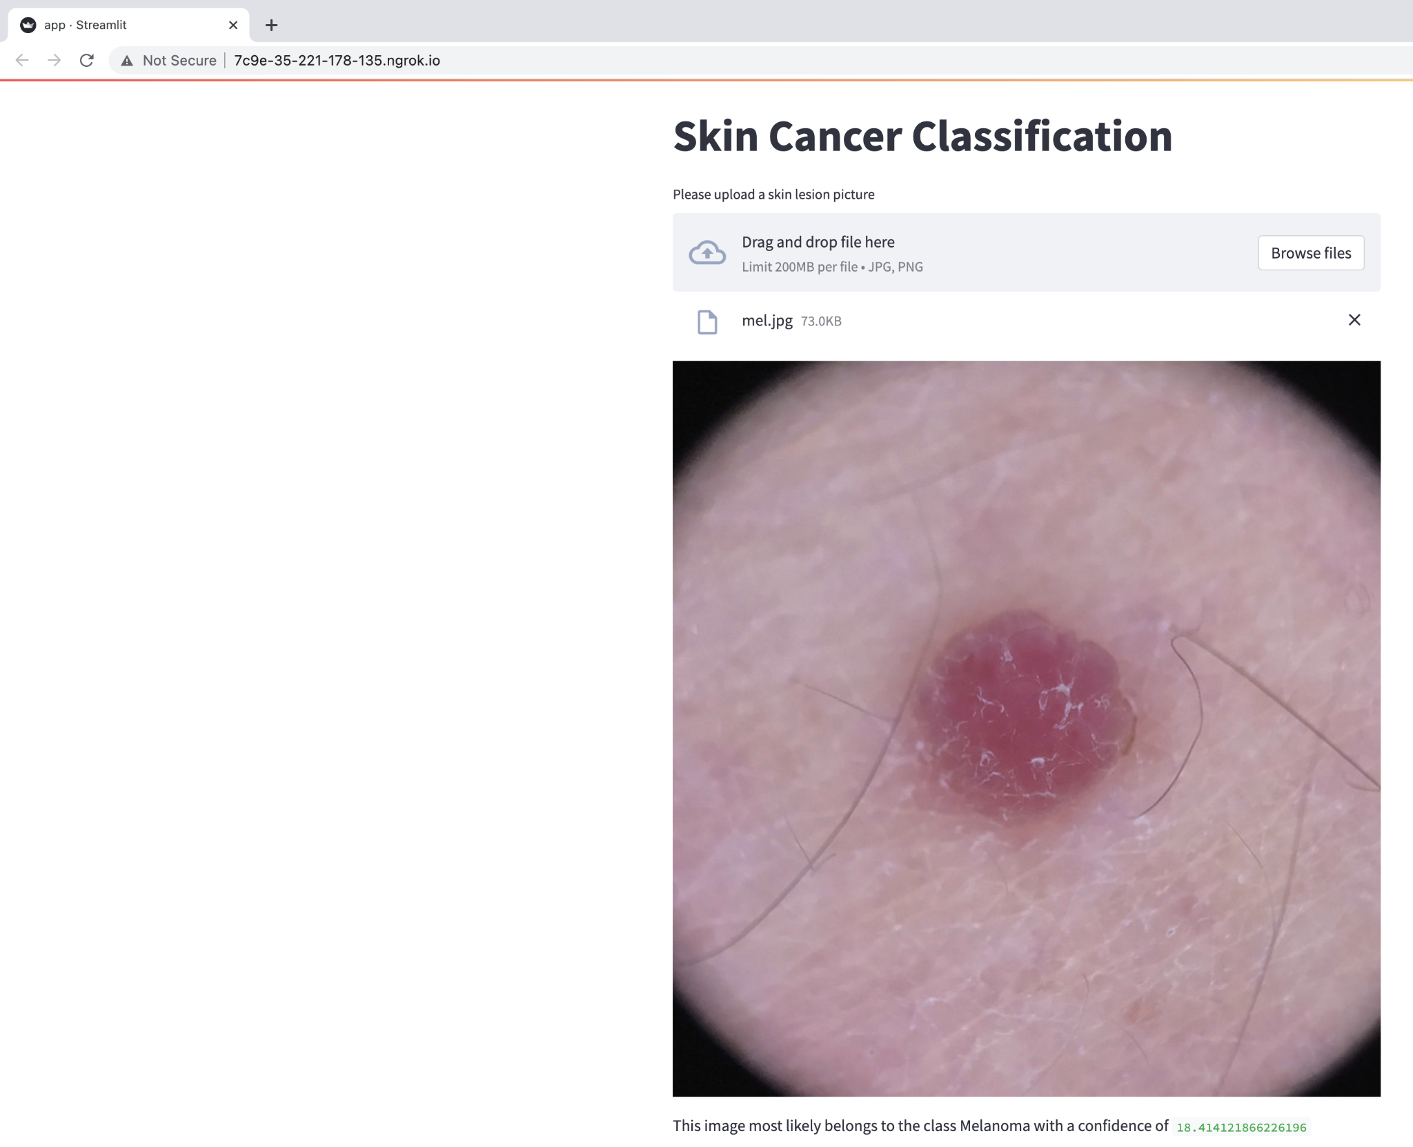
WEB APP
Easy to use User Interface with deployment of model
Upload JPG and PNG images
Streamlit - used for the web application

Slide 22
Thank You
Any
Questions?

Slide 23


